Slide 1
General info from trace using capinfos
File name | _00000_20190410070000.pcap
File type | Wireshark\...-pcapng
File encapsulation | Ethernet
File timestamp precision | microsecond(6)
Packet size limit | file hdr: (not set)
Packet size limit | inferred: 34 bytes - 96 bytes (range)
Number of packets | 1000k
File size | 98MB
Data size | 1099MB
Capture Duration | 3,637099 seconds
First packet time | 2019-04-10 - 07:00:00,056001
Last packet time | 2019-04-10 - 07:00:03,693100
Data byte rate | 302MBps
Data bit rate | 2419Mbps
Average packet size | 1099,84 bytes
Average packet rate | 274kpackets/s

Slide 2
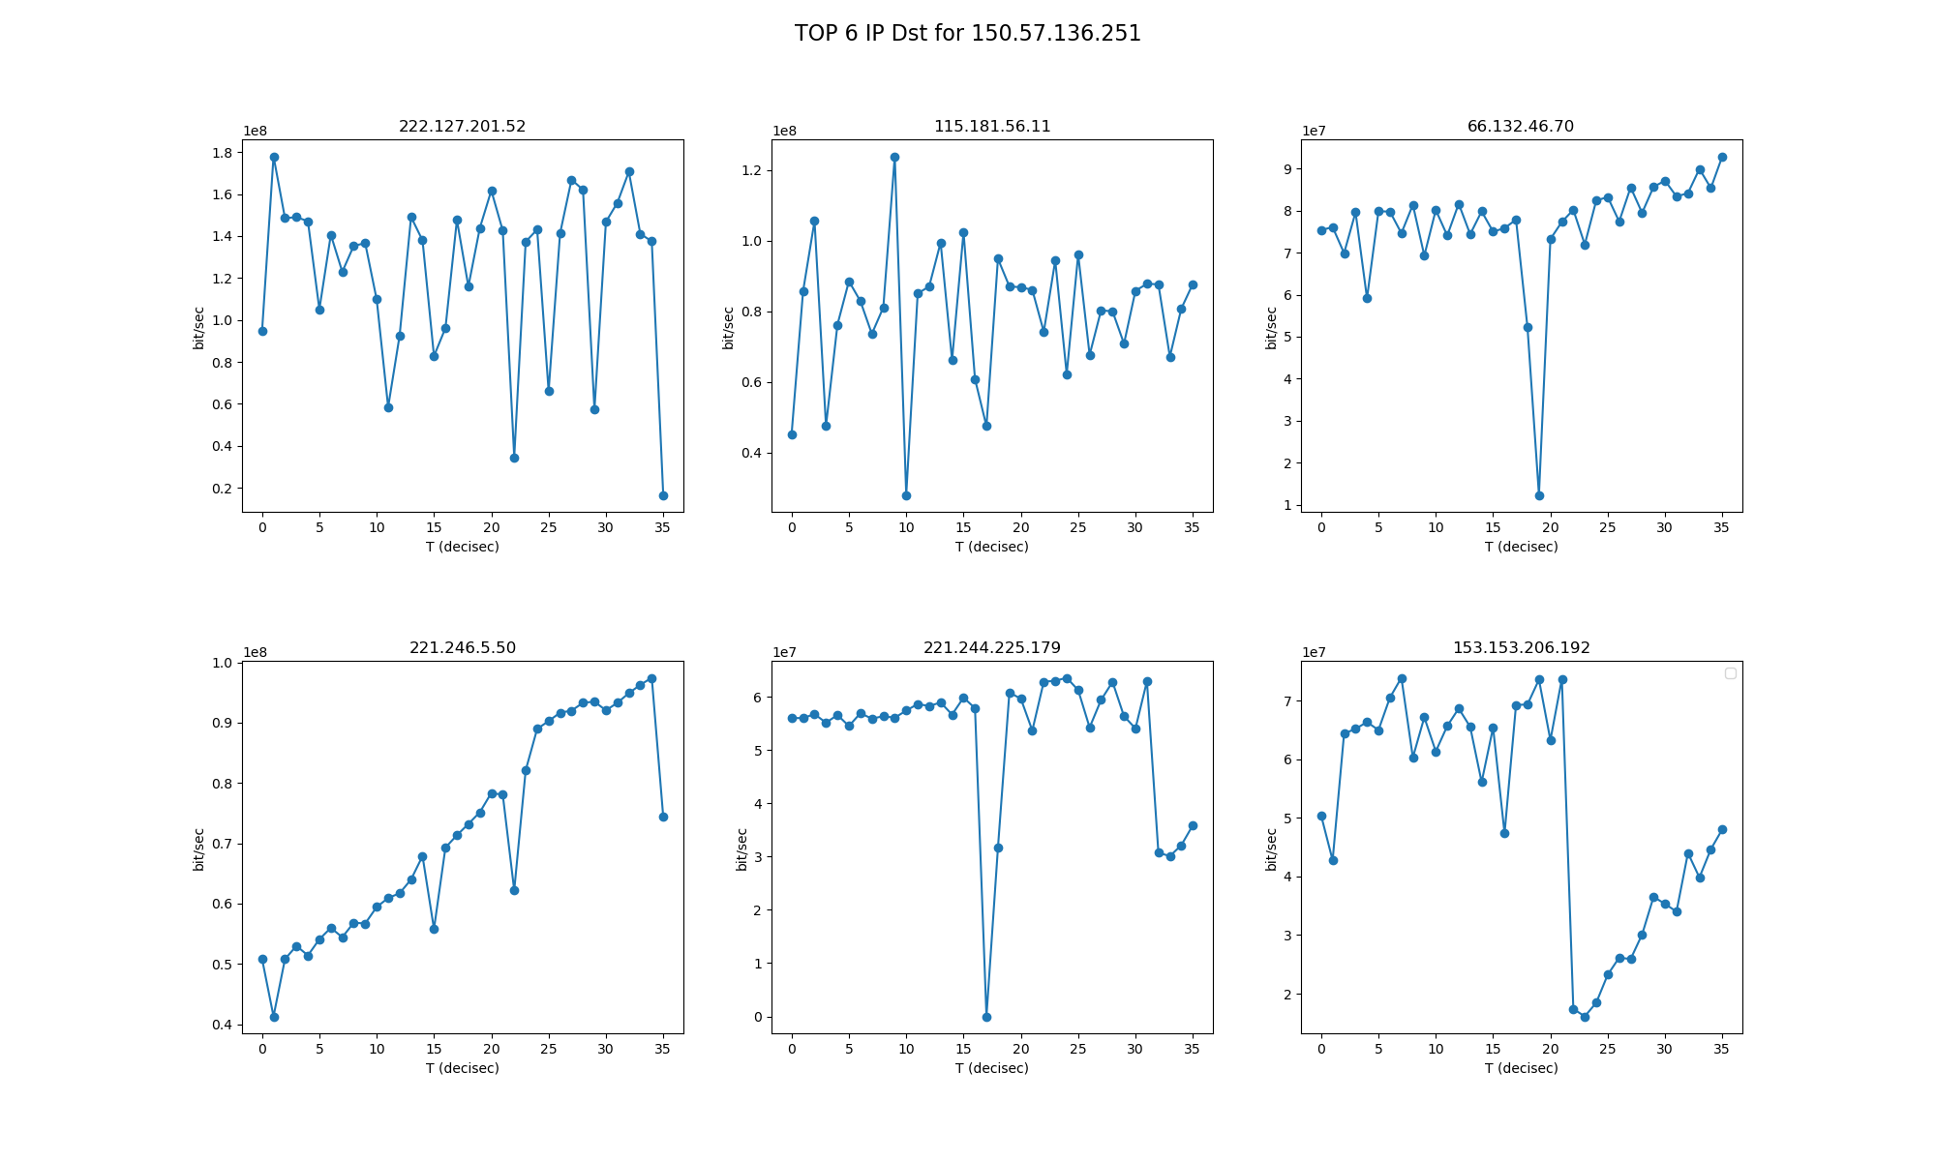

Slide 3
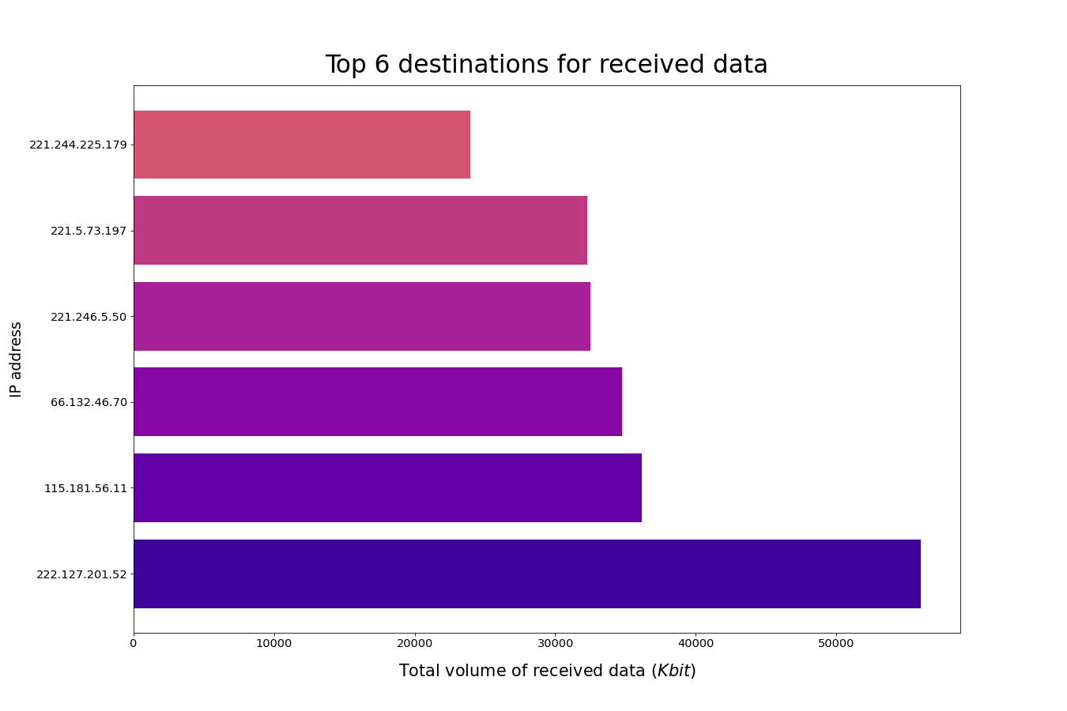

Slide 4
